Slide 1
Ontology Graphical UI
Supervised By:
Dr. Mohammad Ashrafuzzaman Khan
Assistant Professor
ECE Department,North South University.
Mohammad Raihan Sarker Razu
Id- 1520079042
Arona Dorin Chowdhury Id-1520045642
Tamim Ahmed Id- 1520698642

Slide 2
Introduction
The present is the age of information technology. Now the most valuable resource in the world is information or data. The most interesting thing is that the information is linked to one way or another. For example, when we say cancer, we understand that it is related to medical, any algorithm means related to computer science, processor update means related to electrical engineering, etc. These data are stored in the database in a static format, which we do not directly understand which is associated with which. Ontology is used for a visual representation of data in dynamic form. We can easily modify the ontology graph without any data change.

Slide 3
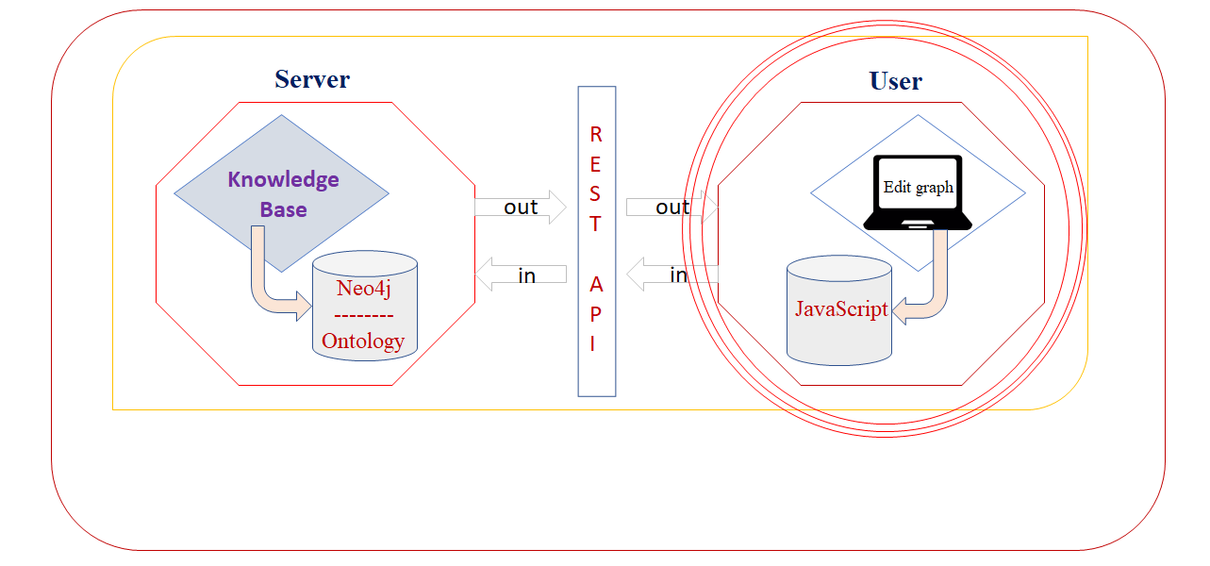
Basic Idea of Our Project
Our target is to finish this part.

Slide 4
Workings of Protégé
Protégé is a free open source ontology editor. Here libraries work differently while making the graph. We can create classes, sub classes and sub sub classes.. We create classes and add sub classes in other sections and we can create the graphs of any model we want. We can save a file and edit the graph anytime we want. Also we can add or delete classes and subclasses anytime according to our choices. By “ontograf” active ontology library we can show the model in graphs. But there are no such API to add protégé to the web platform, as protégé creates dynamic graphs.

Slide 5
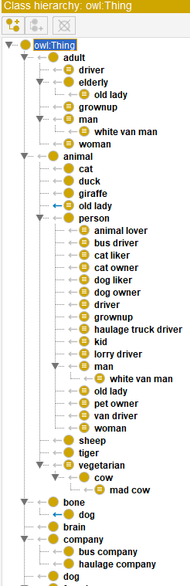
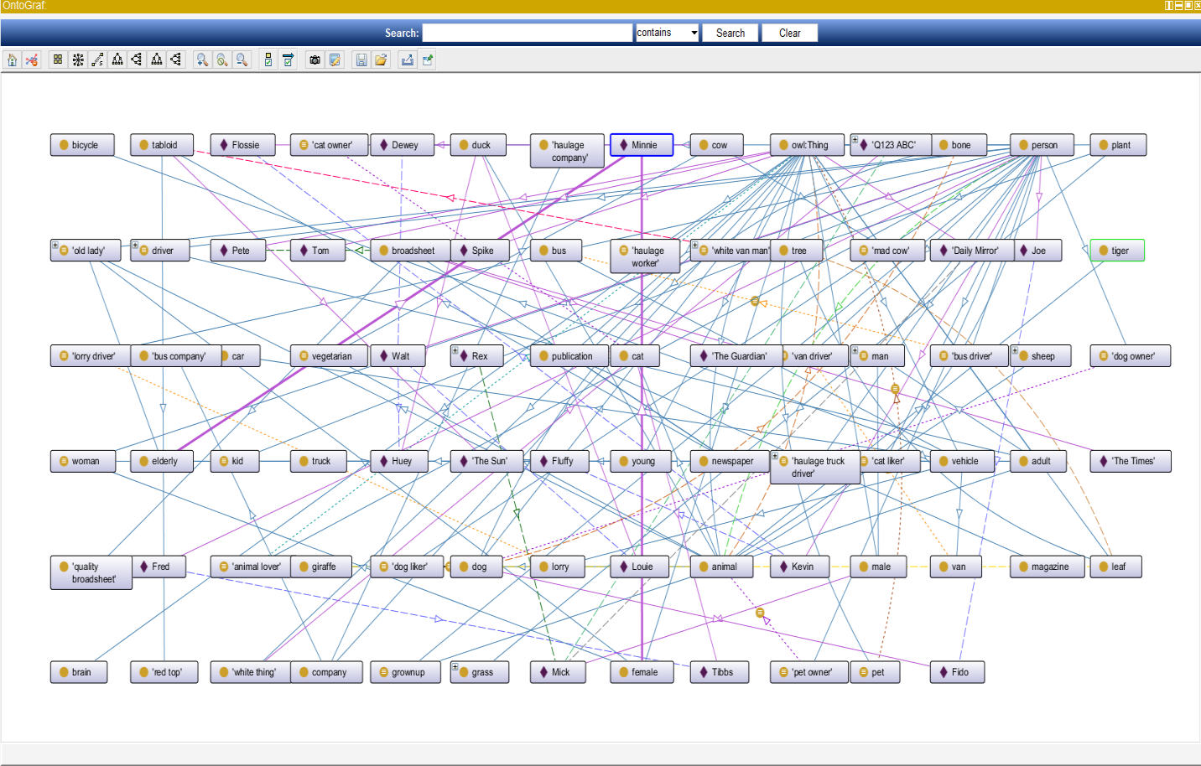
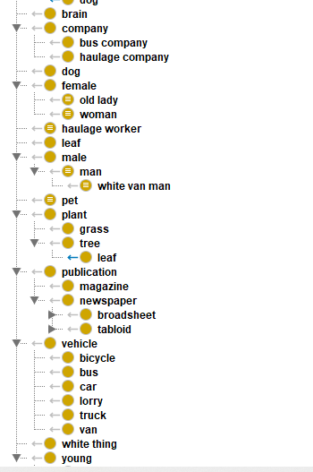
Figures

Slide 6
Developing Dynamic Graph
What are we trying to do?
We are trying to develop a system using the web platform, which will help the user to develop an ontology graph and can easily edit it at any time.
Why are we doing that?
We already know that there are many platforms for creating ontology. They also have some difficulties such as, Once an ontology graph is created, it can no longer be edited, adding, deleting, renaming classes, or subclasses. To do this we need to create new ontology graphs, which is not time effective and flexible process.

Slide 7
Developing Dynamic Graph (cont.)
How are we doing that?
Initially, we are trying to solve this with the web platform. At the very first stage, we search the libraries that are appropriate for our project. For faster and smooth development, we will use some libraries. Mainly we want to try Chartist.js or FusionCharts or Google Charts orChart.js libraries. These libraries will be used primarily to create graphs. As we do this on a web platform so we use HTML5, CSS3, and JavaScript. If there is any server-side work then we will use PHP. For a text editor, we use Visual Code Studio IDE. We decide the first step we collect all the information that related our project, then analyze them to take out the raw material that we needed. In the third step, we develop the graph. After that, the most challenging part of our project is to apply the ontology rule in our graph. At the very last step, we merge all code and modify if it is necessary

Slide 8
Tools
Mainly we try to solve the problem using the below features:
01. Gathering knowledge about the idea,
02. Reading related work papers,
03. Enlisted tools, libraries that we need to solve the problem,
04. developing graph
05. Applying ontology rule into the graph.
Tools to be used
01. HTML5, CSS3, JavaScript
02. PHP [If needed]
04. Library -> Chartist.js or FusionCharts or Google Charts or Chart.js or GOJS.
05. IDE -> Visual Code Studio
06. Server -> Apache 2.4.39 [If needed]
07. Database -> MySQL. [If needed]

Slide 9
Procedure and Development
After gathering all the information and reviewing some papers, we decided to develop a dynamic graph at the beginning. We initially used different libraries to create graphs; Which do not match our work perfectly. Later we got good results by using the GOJS library. We have used GOJS's debug CDN link, it is free so some functions work less in it. To use GOJS release CDN link you have to pay and that is quite a good amount; Minimum 3500 dollars to 9950 dollars.

Slide 10
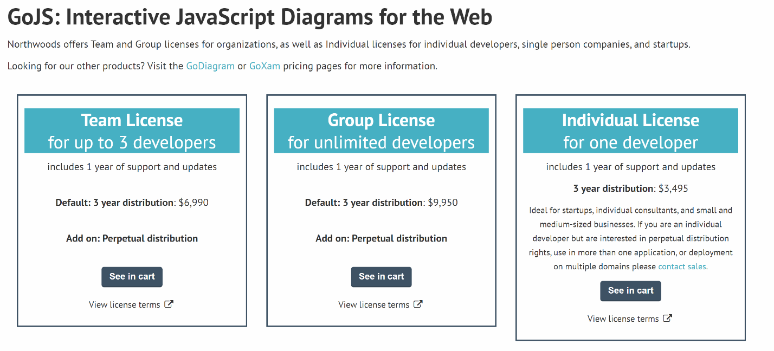
Procedure and Development (CONT.)

Slide 11
Procedure and Development (CONT.)
We used the canvas property inside the HTML to make the graph visible. Moreover, I have used two buttons [save & load] which have been used as on script action/event.
We have used AJAX = Asynchronous JavaScript And XML to make web pages dynamic. Because when we click the button so that the page is not reloaded again and again. This means action/event will work without page reload.
We used the textarea property of HTML to sort the data or to keep it initial. Where I have used 2 arrays. 1 is nodeDataArray [], the other is linkDataArray []. In nodeDataArray we have used 3 variables- id, loc, text. The id here is that the node that I will create will have 1 id. I have used the location loc variable to determine where the node will be located depending on the values ​​of x and y-axis. I have used the text variable to name the node.

Slide 12
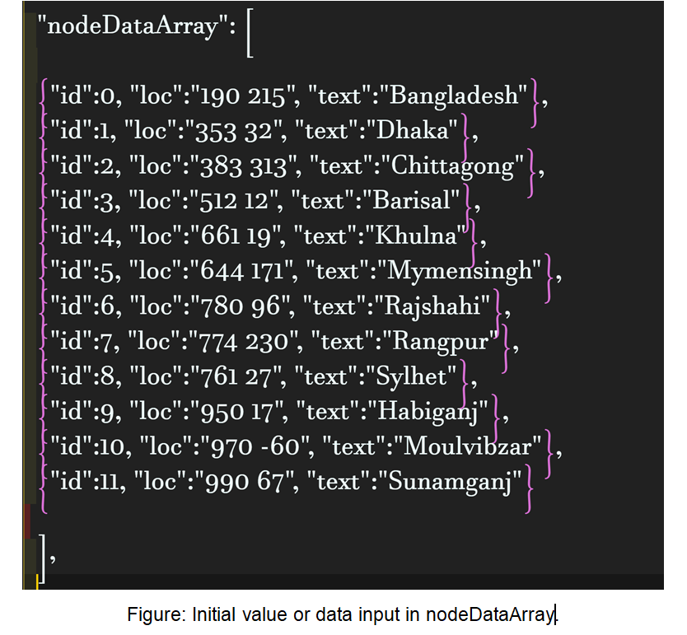
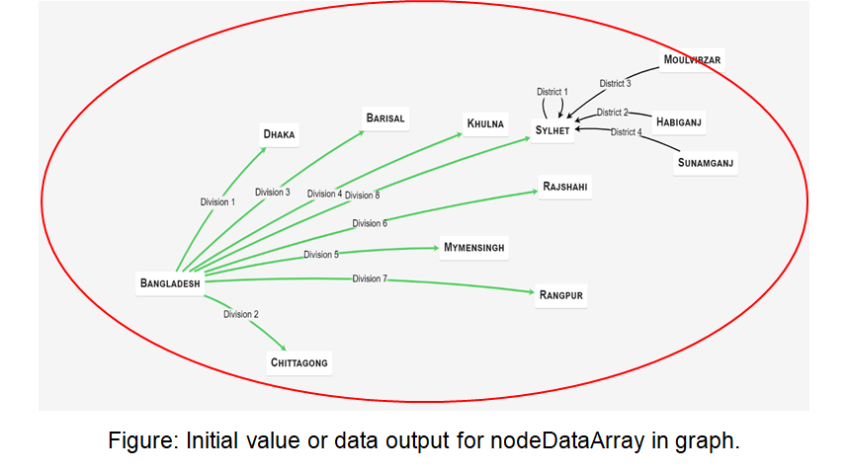
Procedure and Development (CONT.)

Slide 13
Procedure and Development (CONT.)
In linkDataArray we also used 4 variables for class- from, to, progress, text, and entity also used 4 variables but 1 is a little different; curviness instead of progress. Here we have used the id of nodeDataArray in from and to define which node to which arrow will go. progress is a boolean variable. The text here indicates the transaction. I have used the curviness variable in entity to separate entity from class with another color arrow.

Slide 14
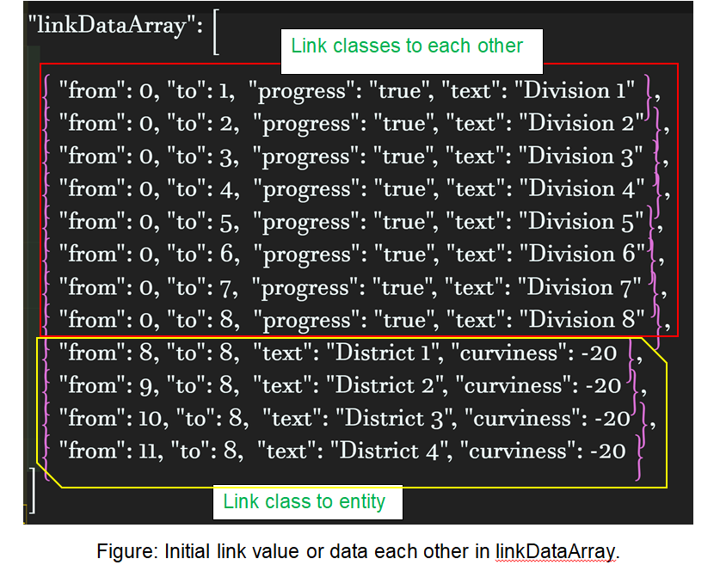
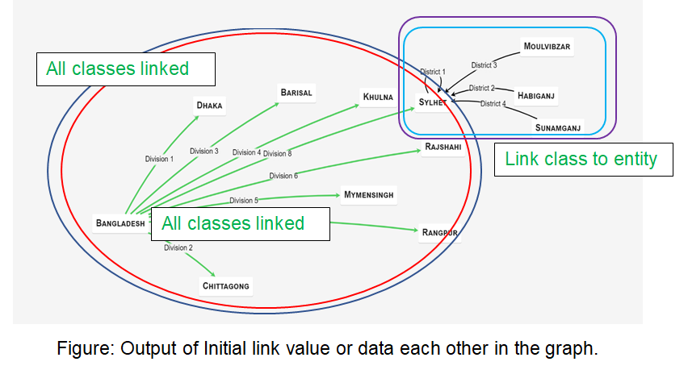
Procedure and Development (CONT.)

Slide 15
Procedure and Development (CONT.)
In CSS we have used 4 simple properties- border, width, height, background. border used to define the boundaries of the graph; width, height to see how much space the graph will take up along the x-axis and y-axis on the screen; I have used background so that the graph is clear.
All types of action / event work is done inside JavaScript. Basically, the work of editing the graph has been done here. The method or action / event that we have used is mentioned. This method of GOJS library is called to zoom in and out the graph with the mouse wheel-

Slide 16
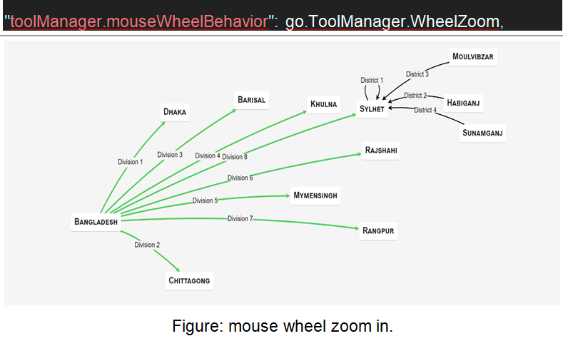
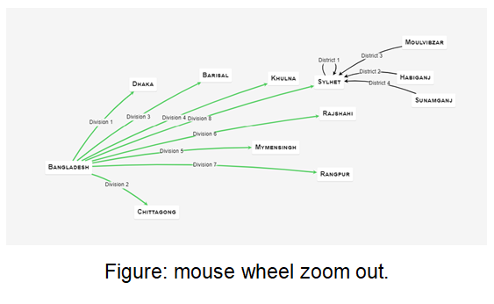
Procedure and Development (CONT.)

Slide 17
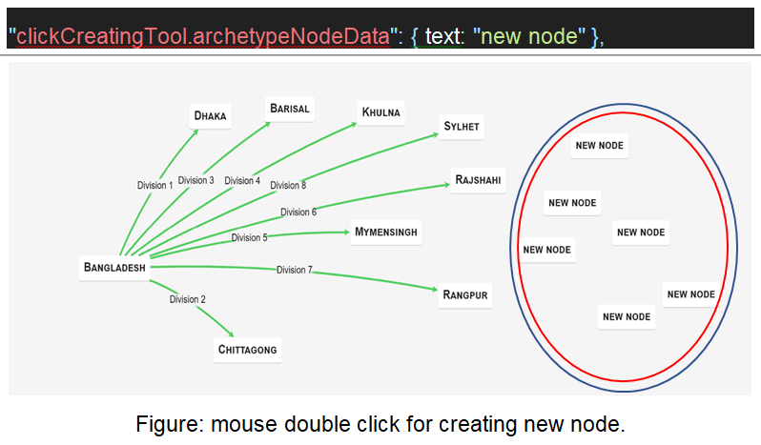
Procedure and Development (CONT.)
This method of GOJS library is called to create new nodes by double-clicking on empty space-

Slide 18
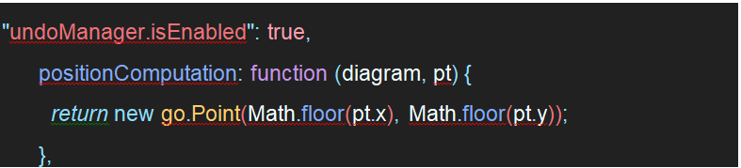
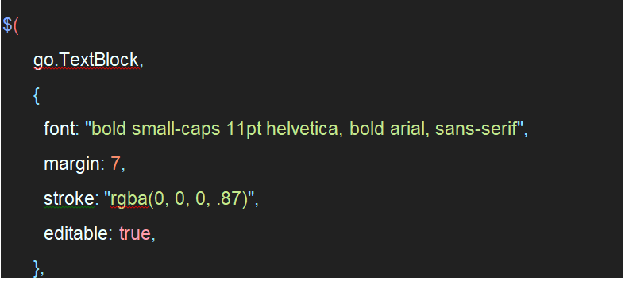
Procedure and Development (CONT.)
The following function is called to undo [Ctrl+Z] & redo [Ctrl+Y] by the keyboard-
We have used this method to edit existing text-

Slide 19
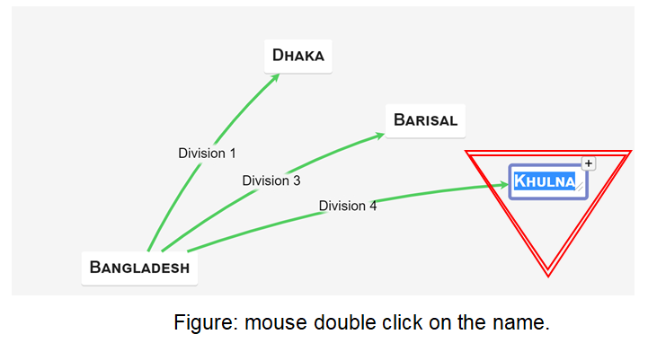
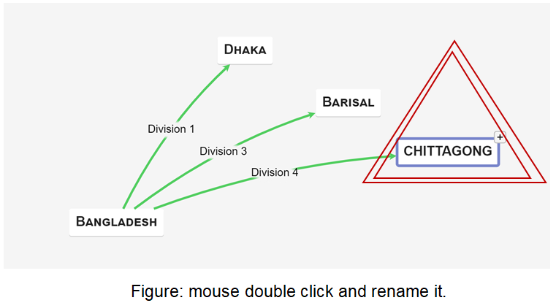
Procedure and Development (CONT.)

Slide 20
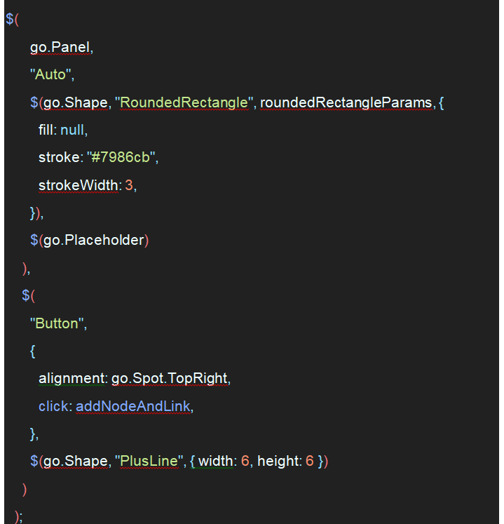
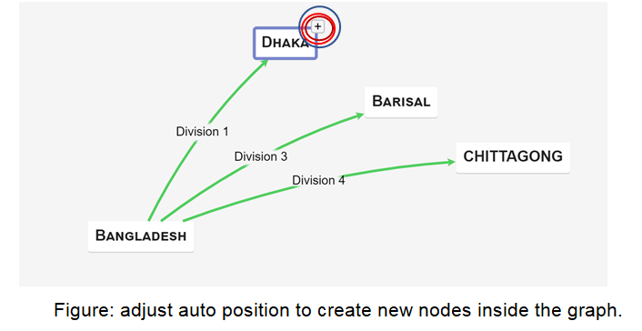
Procedure and Development (CONT.)
I have used this function to adjust its auto position to create new nodes inside the graph-

Slide 21
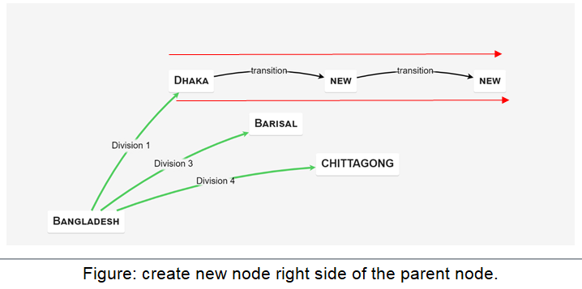
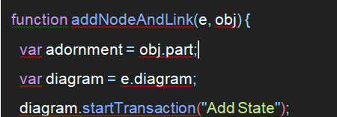
Procedure and Development (CONT.)
Clicking the button inserts a new node to the right of the selected node, and adds a link to that new node.

Slide 22
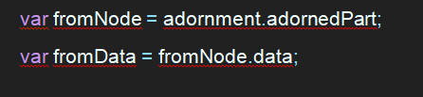
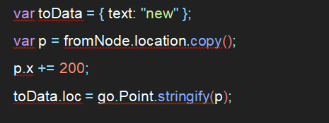
Procedure and Development (CONT.)
Get the node data for which the user clicked the button.
Create a new "State" data object, positioned off to the right of the adorned Node.

Slide 23
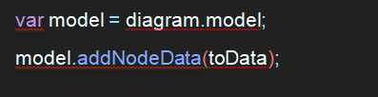
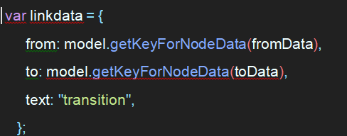
Procedure and Development (CONT.)
Add the new node data to the model.
Create a link data from the old node data to the new node data.

Slide 24
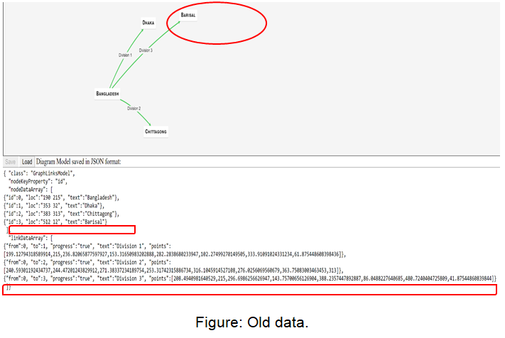
Procedure and Development (CONT.)

Slide 25
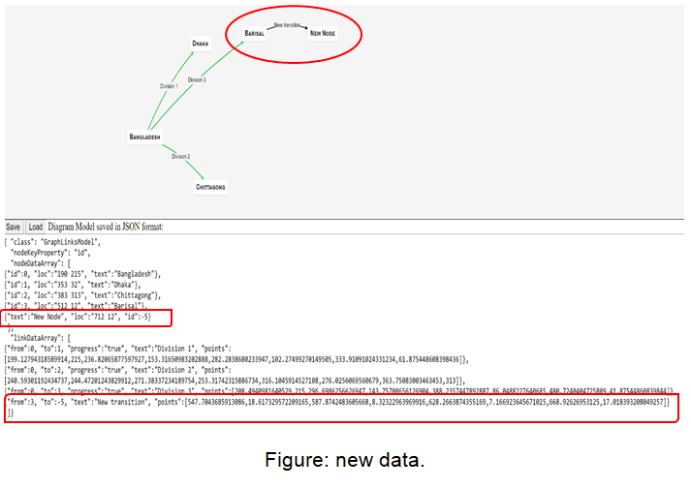
Procedure and Development (CONT.)

Slide 26
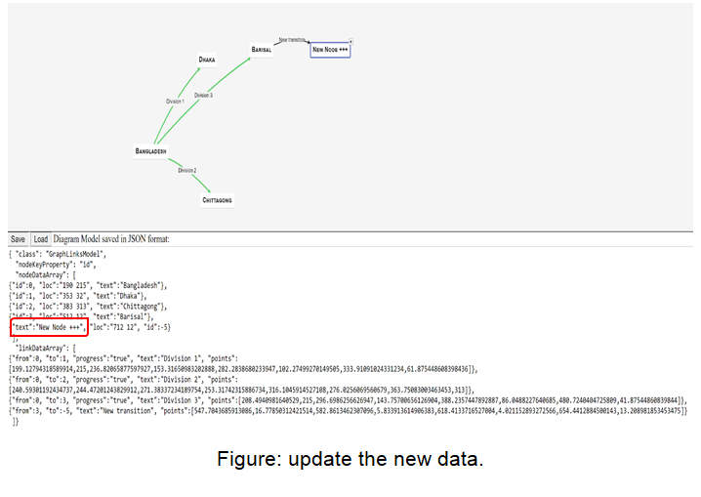
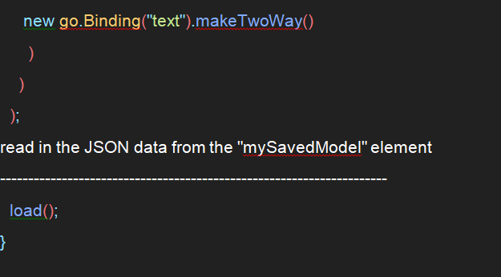
Procedure and Development (CONT.)
Editing the text automatically updates the model data.

Slide 27
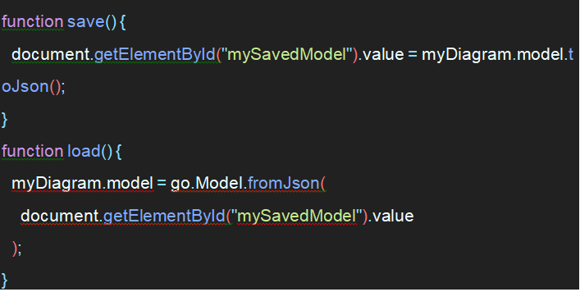
Procedure and Development (CONT.)
We can easily DELETE a node using keyboard delete button. First single mouse clicks on the node then delete it.
Show the diagram’s model in JSON format.

Slide 28
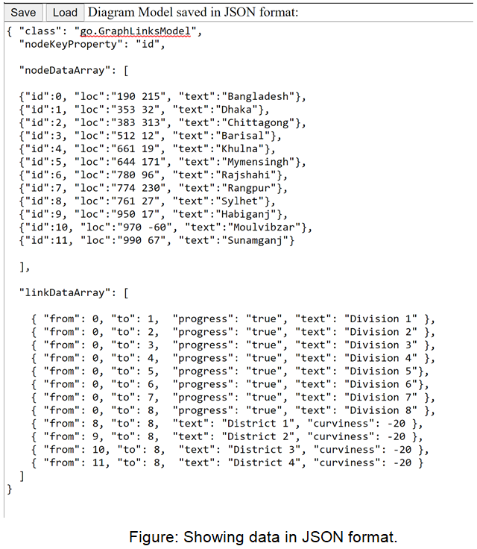
Procedure and Development (CONT.)
After completing the graph development our next goal was implement the ontology rule into the graph. But unfortunately, my [Mohammad Raihan Sarker Razu] sickness I can not able to work to implement this part.

Slide 29
Challenges and Difficulties
The first problem we face is when we are going to gather information about our related project we find a few of data. Because there is not much ontology related work. Later we get some papers and web site links with the help of our esteemed factory, from which we collect a lot of information. Then you have to try many libraries to create graphs. The ones I used on May 1, such as Chartist.js or FusionCharts or Google Charts or Chart.js, were static graphs in the form of plots; But we needed a dynamic graph. After 10 days of searching, I found JavaScript's GOJS library. Which will help us to create the desired graph. Later with GOJS library we were able to create graphs for Ontology.
We have also had a lot of environmental problems. Corona Pandemic has had a lot of impact on our group work. Everyone had more or less internet problems when they went to their homes. It's a good time to do things that would have been done in a short time if we had been together. Before the graph was created, our group mate Mohammad Raihan Sarker Razu had a fever for about 10 days in early August. After recovering, I completed the work. Mohammad Raihan Sarker Razu has been sick again since September 10th; This time he is suffering from fever, muscle pain and sore throat. His father has been suffering from the same disease since 5 days after he got sick. When he called the doctor later, he gave them some medicine and forbade them to go out of the house and ask him to rest in bed. Mohammad Raihan Sarker Razu is still ill, unable to fully implement the ontology rules.

Slide 30
Conclusion
As mentioned earlier, we faced some problems in 499A, while finding APIs to include protégé into web platform. Also there are very few information on internet about how protégé works. We read some research papers according to our course instructor's advice which helped us a lot. We have learned how protégé creates a graph according to our given classes and sub classes. We can also edit, add and delete the classes by our own preferences. We learned the importance of a stable data graph in various work sectors, like in biomedicine, e-commerce, and organizational modeling. Then in 499B we started to works on dynamic graph and web platform. By using raw HTLM and raw JaAVAScript (GOJS library) we can now create a dynamic graph and can edit the graph as well. We also added some features which we have mentioned earlier.

Slide 31
Reference
Knublauch, Holger. "Ontology-driven software development in the context of the semantic web: An example scenario with Protege/OWL." 1st International workshop on the model-driven semantic web (MDSW2004). Monterey, California, USA.[WWW document] http://www. knublauch. com/publications/MDSW2004. pdf, 2004.
Musen, Mark A. "The protégé project: a look back and a look forward." AI matters 1.4 (2015): 4-12.
Gennari, John H., et al. "The evolution of Protégé: an environment for knowledge-based systems development." International Journal of Human-computer studies 58.1 (2003): 89-123.
Wongthongtham, Pornpit, et al. "Software engineering ontologies and their implementation." Proceedings of the IASTED International Conference on Software Engineering (SE). ACTA Publishing, 2005.

Slide 32
THANK YOU

